Slide 1
Today’s Questions
Fill in your planner
Why was each colonial region founded?

Slide 2
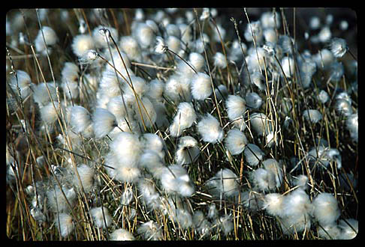
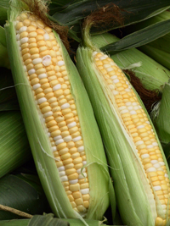
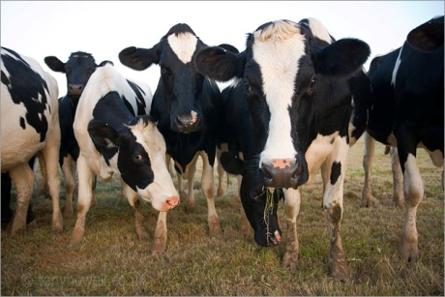
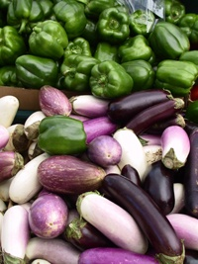
Vocabulary
cash crops – a crop grown to be sold for money; not to be eaten. Prime examples are tobacco, cotton, and indigo
subsistence farming – producing just enough food for the family and a little extra to trade in town

Slide 3
The 13 Colonies
The 3 colonial regions &
why they were founded

Slide 4
Between about 1630 and 1640, a religious group called the Puritans left England to escape bad treatment by King James I. Unlike the Separatists, who wanted to break away from the Church of England, the Puritans wanted to reform, or "purify," its practices. By the thousands, Puritan families left for the Americas. Their leaving is known as the Great Migration. Many thousands of Puritans left their homeland to found new settlements around the world. Of these settlers, about 20,000 crossed the Atlantic Ocean to New England.
Page 94 – “The Puritans Come to Massachusetts Bay”

Slide 5
Religious freedom attracted many groups, including Protestants, Catholics, Quakers, and Jews. The Hudson and Delaware rivers supported shipping and commerce. The river valleys had rich soil and mild winters. These conditions were favorable for farming and raising livestock.
Page 100 – “The Middle Colonies”

Slide 6
Page 102 –
“The Southern Colonies”
The new Southern Colonies were Maryland, the Carolinas, and Georgia. The Appalachian Mountains bordered parts of these colonies in the west. In the east, the colonies bordered the Atlantic Ocean. The soil and climate of this region were suitable for warm-weather crops such as tobacco, rice, and indigo.

Slide 7
Page 37 in comp book

